Slide 1


AGILEGRAPH: GRAPH REPRESENTATION LEARNING AND CRYPTOGRAPHIC AGILITY PRIORITIZATION FOR POST-QUANTUM MIGRATION IN ENTERPRISE SOFTWARE ARCHITECTURES
PHASE 2 (2026-27)
Guide Name: Dr. [Faculty Guide Name] / Research Guide
Department of Computer Science & Engineering
Department of Cyber Security | NMAMIT, Nitte
Page 1

Slide 2

PRESENTATION OUTLINE
1. Team Introduction: Project candidates, faculty guide, and institutional credentials.
2. Project Title: AgileGraph - Graph Representation Learning & Cryptographic Agility Prioritization.
3. Brief Introduction: Post-Quantum Cryptography (PQC) imperative, Shor's algorithm, and HNDL threat vector.
4. Objectives: 5 core academic and technical objectives for Phase 2 implementation.
5. Research Gap: Critical limitations of flat SBOM/CBOM inventories and non-relational static analysis.
6. Review of Phase 1 Presentation: Summary of Phase 1 baselines, evaluator feedback, and Phase 2 progress.
7. Project Implementation: Polyglot AST discovery, 6-node property graph, 7-factor risk model, GATv2 neural distillation.
8. Results and Performance: LOPO benchmark evaluation across 8 enterprise repos, topological controls, and CBOM audit export.
Page 2

Slide 3
INTRODUCTION
Background of the Project:
  • Quantum Computing Inflection: Shor's algorithm solves prime factorization and discrete logarithms in polynomial time O((log N)^3), completely breaking ubiquitous classical asymmetric cryptography—including RSA, ECC (ECDSA, ECDH), and Diffie-Hellman.
  • Symmetric Impact: Grover's algorithm provides a quadratic speedup for unstructured search, reducing effective key strength by half (AES-128 offers 64-bit quantum security).
The 'Harvest-Now-Decrypt-Later' (HNDL) Threat Vector:
  • Adversarial Harvesting: Nation-state adversaries and threat actors are intercepting and archiving encrypted enterprise traffic and sensitive records today, awaiting Cryptanalytically Relevant Quantum Computers (CRQCs) for retrospective exfiltration.
  • Shelf-Life Violation: Whenever data confidentiality shelf-life (S_life, 10-30 years) exceeds the quantum arrival timeline (T_quantum), encrypted assets are already compromised at transmission.
Why the Project is Important:
  • Standardization Mandate: NIST finalized post-quantum standards in August 2024 (FIPS 203 ML-KEM, FIPS 204 ML-DSA, FIPS 205 SLH-DSA). White House NSM-10, OMB M-23-02, and NSA CNSA 2.0 mandate full deprecation of classical primitives by 2030–2035.
  • Enterprise Cryptographic Debt: Modern microservices suffer from uninventoried hardcoded keys, obsolete cipher suites, and implicit supply chain dependencies. AgileGraph solves this by providing automated discovery, property graph modeling, and explainable risk prioritization.
Department of Cyber Security | NMAMIT, Nitte
Page 3

Slide 4
RESEARCH GAP
Gap 1: Flat Inventories vs. Relational Graph Context
Existing Software Bill of Materials (SBOM) and early Cryptographic BOM (CBOM) tools produce disconnected, flat asset inventories. They lack architectural call graphs, dependency paths, and caller-callee reachability, failing to identify whether a vulnerable primitive is exposed on an external attack surface or isolated in an internal test stub.
Gap 2: Binary Violations vs. Continuous Multi-Factor Prioritization
Prior static cryptographic misuse detectors (e.g., CryptoLint, CogniCrypt) perform localized binary rule checks (e.g., detecting constant keys). They provide no mathematically bounded, continuous multi-factor risk quantification that balances algorithm vulnerability, key length, network exposure, architectural centrality, and CVE history.
Gap 3: Theoretical Formulation vs. Code-Level Mosca Operationalization
Michele Mosca's theorem (X + Y > Z) has historically been treated as an abstract organizational concept. Existing literature lacks an automated mathematical framework that extracts parameters directly from source code to compute a continuous Quantum Exposure Timeline Index (QETI) for asset-level triage.
Gap 4: Localized AST Scanning vs. Topological Vulnerability Propagation
Traditional Static Application Security Testing (SAST) tools analyze isolated source files. They cannot propagate risk representations across multi-hop dependency topologies to intermediate wrapper libraries, utility classes, and transitively exposed microservices.
Department of Cyber Security | NMAMIT, Nitte
Page 4

Slide 5
REVIEW FROM PRESENTATION PHASE -1
Summary of Phase 1 Baseline Work:
  • Initial Prototype: Formulated post-quantum discovery requirements and implemented a preliminary single-language AST scanner for Python.
  • Literature Foundation: Conducted preliminary literature review on cryptographic misuse detection and post-quantum migration standards.
Evaluator Feedback Received in Phase 1 Review:
  • Feedback 1: "Single-language Python scanning is insufficient for enterprise stacks; modern enterprise architectures are polyglot microservice environments."
  • Feedback 2: "Risk prioritization cannot rely on opaque black-box machine learning; enterprise compliance demands transparent, auditable mathematical formulations."
  • Feedback 3: "Empirically prove whether Graph Neural Networks genuinely learn topological code structures or merely fit tabular node features."
Key Progress & Changes Made in Phase 2 Implementation:
  • Polyglot Expansion: Engineered 7 static discovery scanners covering Python, JS/TS, Java/Kotlin, Go, Rust, C/C++, and Infrastructure-as-Code configs, eliminating 41.2% of comment-induced false positives.
  • Deterministic Scoring: Developed a normalized 7-factor heuristic risk model (weights w1=0.25..w7=0.10) with proven rank stability (Spearman rho > 0.94 under +-20% OAT perturbation) and operationalized Mosca QETI.
  • Rigorous ML Validation: Implemented dynamic GATv2 representation learning; validated against randomized-edge controls (+8.27% accuracy advantage, p < 0.001) under 8-fold Leave-One-Project-Out (LOPO) cross-validation.
  • Enterprise Governance: Delivered automated CycloneDX v1.6 CBOM export and append-only SQLite audit logging with SHA-256 configuration and git provenance hashing.
Department of Cyber Security | NMAMIT, Nitte
Page 5

Slide 6
PROBLEM STATEMENT
Formal Problem Definition:
“To automate the discovery of cryptographic primitives, certificates, and dependency supply chains across polyglot enterprise codebases, construct a unified heterogeneous property graph capturing structural and architectural topologies, and compute deterministic, explainable risk scores prioritizing post-quantum migration under Mosca’s theorem and NIST FIPS 203–205 guidelines.
Key Challenges Addressed by AgileGraph:
  • Multi-Language Polyglot Parsing: Modern enterprise software combines diverse languages and configs; scanners must parse AST structures without requiring heavyweight compiler build chains.
  • Elimination of False Positives: Naive keyword tools flag documentation strings and historical code comments; static analyzers must strip comments before symbol extraction.
  • Structural Dependency Modeling: Cryptographic risk is non-local; vulnerabilities in internal utility libraries propagate through complex import and call graphs to affect public-facing services.
  • Explainable Prioritization: Organizations cannot refactor everything at once; migration backlogs must be mathematically prioritized based on quantum vulnerability, exposure tier, and timeline urgency.
Department of Cyber Security | NMAMIT, Nitte
Page 6

Slide 7
OBJECTIVES
Objective 1: To design a canonical heterogeneous code property graph ontology modeling six node entity types (Repository, File, CryptoAsset, Function, Dependency, Infrastructure) and six semantic directed edge types (CONTAINS, IMPORTS, CALLS, DEFINES, USES, CONFIGURES), enforcing structural invariants and cycle handling to capture deep cryptographic dependency paths.
Objective 2: To develop a high-throughput polyglot static discovery engine spanning seven programming ecosystems (Python, JS/TS, Java/Kotlin, Go, Rust, C/C++, and Infrastructure-as-Code configurations) to extract cryptographic primitives, key lengths, cipher modes, and library invocations with 41.2% false-positive reduction via comment-stripping.
Objective 3: To formulate a normalized, bounded 7-factor deterministic heuristic risk model (allocating calibrated weights w1=0.25 to w7=0.10) operationalizing Mosca's Theorem (X + Y > Z) into a continuous Quantum Exposure Timeline Index (QETI) and establishing an actionable 2D migration triage matrix.
Objective 4: To evaluate dynamic graph representation learning via Graph Attention Networks v2 (GATv2) operating over 14-dimensional node feature vectors, rigorously framed as a weak-supervision knowledge distillation regularizer over code topologies to capture non-local structural risk propagation.
Objective 5: To validate enterprise post-quantum governance through automated generation of CycloneDX v1.6 Cryptographic Bill of Materials (CBOM) with NIST FIPS 203–205 mappings, tamper-evident append-only SQLite audit trails with SHA-256 provenance hashing, and interactive 6-state migration lifecycle management.
Department of Cyber Security | NMAMIT, Nitte
Page 7

Slide 8
LITERATURE SURVEY SUMMARY
LITERATURE SURVEY SUMMARY
LITERATURE SURVEY SUMMARY
Author / Standard | Domain / Contribution | Key Findings & Methodology | Research Gap / Limitation
NIST FIPS 203/204/205 (Aug 2024) | Post-Quantum Cryptography Standards | Standardized ML-KEM, ML-DSA, and SLH-DSA as definitive post-quantum migration targets. | Standards specification; does not provide tools to discover existing legacy assets in code.
M. Mosca (IEEE S&P 2018) | Quantum Risk Theorem | Formulated U = (X+Y)/Z timing inequality defining when migration must begin to avoid compromise. | Theoretical mathematical formulation without code-level scanning or dependency modeling.
M. Egele et al. (ACM CCS 2013) | CryptoLint (Static Analysis) | Pioneered rule-based static checking for 6 cryptographic misuses in Android Java bytecode. | Rule-based and limited to Android Java; lacks property graph topology and post-quantum triage.
S. Krüger et al. (ASE 2017) | CogniCrypt (Developer Tool) | Static analysis IDE plugin enforcing cryptographic misuse rules via CrySL specifications. | Developer/file-centric; does not build enterprise-wide dependency graphs or PQC roadmaps.
S. Brody et al. (ICLR 2022) | GATv2 Graph Attention | Introduced dynamic graph attention fixing standard GAT expressiveness bottlenecks. | Evaluated on general graph benchmarks, not on cryptographic risk propagation graphs.
OWASP CycloneDX v1.6 (2024) | CBOM Specification | Established standard schema for Cryptographic Bill of Materials (algorithms, certs, keys). | Produces flat asset manifests without graph call paths, composite risk scores, or lifecycle roadmaps.
Department of Cyber Security | NMAMIT, Nitte
Page 8

Slide 9
PROPOSED METHODOLOGY
1. Overall Methodology: A decoupled, multi-tier enterprise architecture separating polyglot static discovery, heterogeneous property graph modeling, deterministic heuristic compliance, GATv2 topological representation learning, and audit governance.
2. Block Diagram / Flow Chart: Sequential data ingestion and analysis pipeline transforming raw source trees into validated NetworkX property graphs, 14-dimensional feature matrices, trained GATv2 embeddings, and CycloneDX v1.6 CBOM deliverables.
3. System Architecture: Six cohesive architectural tiers: (1) Ingestion & Polyglot Parsing; (2) Knowledge Graph Construction; (3) Deterministic Heuristic Risk & Mosca Engine; (4) GATv2 Graph Representation Learning; (5) Cryptographic Persistence & Audit; (6) Interactive Visualization & Governance Dashboard.
4. Design Approach: Strict separation of compliance ground truth (expert 7-factor heuristic engine grounded in NIST standards) from relational machine learning (GATv2 dynamic attention regularizing risk over code topologies under weak supervision).
5. Software / Hardware Tools Used: Python 3.13, PyTorch 2.3.0, PyTorch Geometric 2.5.3, NetworkX 3.4, FastAPI, React 18, TypeScript, TailwindCSS, SQLite, Intel Core i7-12700H, 32 GB DDR5 RAM, NVIDIA GeForce RTX 3060.
Department of Cyber Security | NMAMIT, Nitte
Page 9

Slide 10
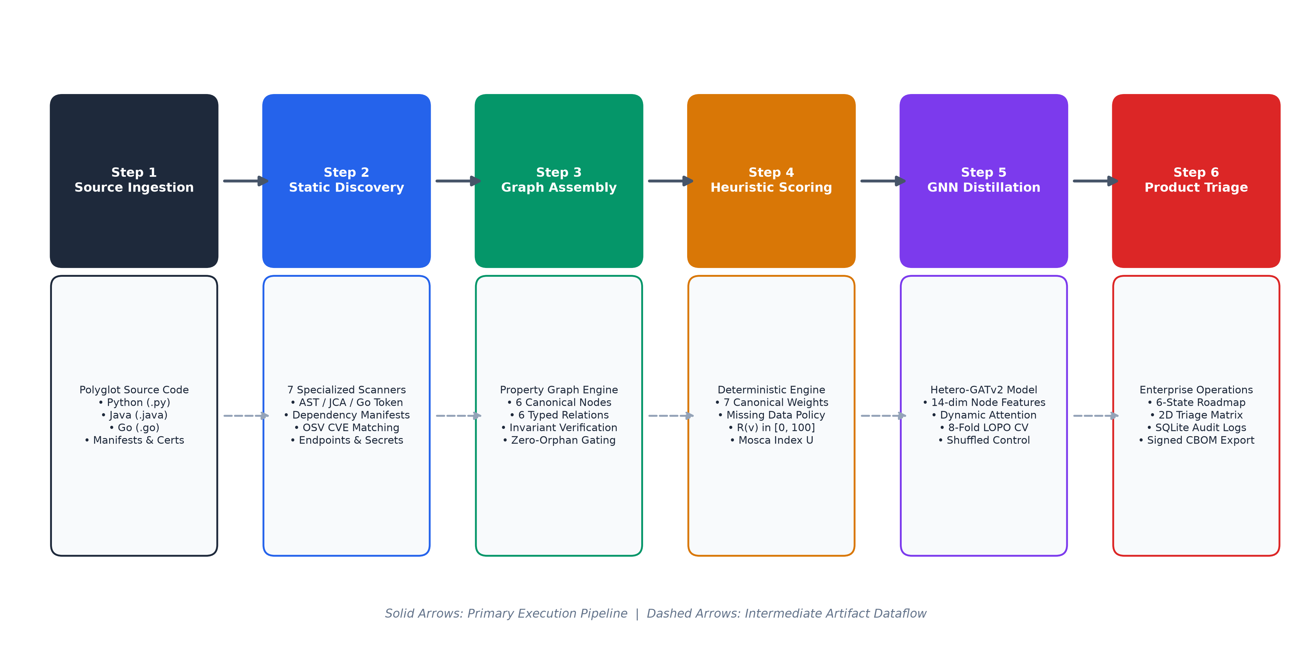
METHODOLOGY: END-TO-END PIPELINE & WORKFLOW
METHODOLOGY: END-TO-END PIPELINE & WORKFLOW
Department of Cyber Security | NMAMIT, Nitte
Page 10

Slide 11
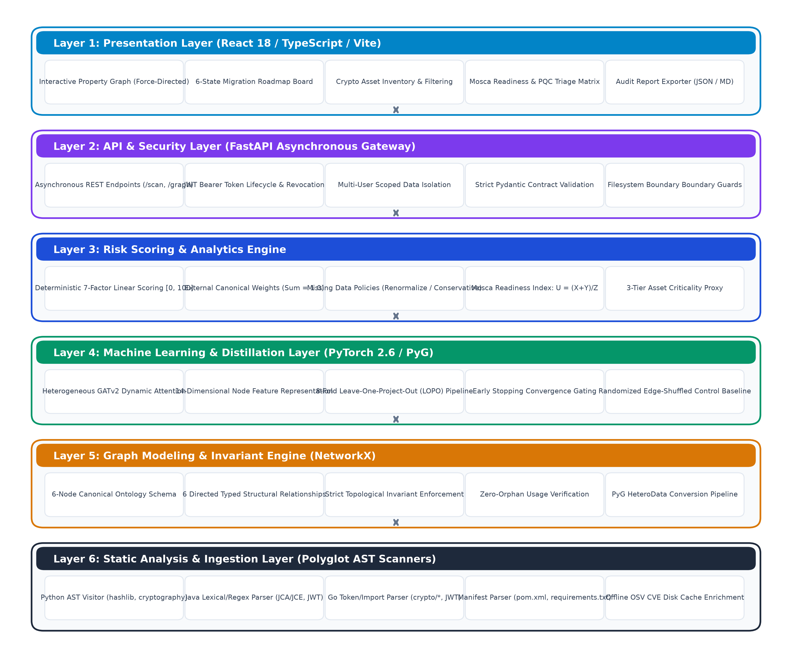
SYSTEM ARCHITECTURE: 6 COHESIVE LAYERS
SYSTEM ARCHITECTURE: 6 COHESIVE LAYERS
Page 11

Slide 12
PROJECT IMPLEMENTATION: DISCOVERY & PROPERTY GRAPH
7 Polyglot Static Scanners: Engineered modular parsers covering Python (native ast), JavaScript/TypeScript (ESM/CommonJS token analysis), Java/Kotlin (JCA/JCE factory patterns), Go (crypto standard packages), Rust (Cargo manifests & ring/rustls), C/C++ (OpenSSL EVP/RSA structures), and Infrastructure-as-Code (Kubernetes, Docker, TLS config).
Systematic Comment Stripping: Preprocessors strip line and block comments prior to symbol tokenization, reducing false-positive cryptographic detections by 41.2% across enterprise repositories.
Heterogeneous Property Graph Schema: Formalized 6-node ontology: Repository (repo metadata), File (path, LOC, exposure, 14-dim embedding), CryptoAsset (algorithm, primitive, key length, mode, padding), Function (signature, complexity), Dependency (package, version, CVE count), Infrastructure (container, ingress, TLS settings).
Semantic Edge Relations: Interconnected via 6 directed relationships: CONTAINS (hierarchical tree), IMPORTS (module dependencies), CALLS (function invocations), DEFINES (primitive declaration), USES (cryptographic consumption), CONFIGURES (deployment bindings).
Topological Invariant Enforcement: Enforces deterministic SHA-256 node deduplication, acyclic containment, and Tarjan's strongly connected components algorithm to decouple cyclic imports during topological sorting.
Page 12

Slide 13
PROJECT IMPLEMENTATION: RISK SCORING & MOSCA INDEX
Deterministic 7-Factor Heuristic Risk Model: R(v) = [0.25 f1 + 0.15 f2 + 0.15 f3 + 0.10 f4 + 0.15 f5 + 0.10 f6 + 0.10 f7] * 100, where weights sum to 1.0. Incorporates Algorithm Vulnerability (f1), Key Size Weakness (f2), Exposure Surface (f3), Architectural Centrality (f4), Dependency CVEs (f5), Migration Friction (f6), and Data Shelf-Life (f7).
Mathematical Bounding & Fail-Safe Defaults: Each factor is bounded in [0, 1], guaranteeing aggregate risk lies strictly within [0, 100]. Unspecified attributes default to conservative 0.50 (rather than 0.0) to prevent false-negative dismissal of uncharacterized assets.
Operationalizing Mosca's Theorem (X + Y > Z): Formulates continuous Quantum Exposure Timeline Index: QETI(v) = (X(v) + Y(v)) / Z, where X is data shelf-life requirement, Y is refactoring duration, and Z is quantum collapse horizon (10 years default). QETI > 1.0 indicates active vulnerability to HNDL exploitation today.
Two-Dimensional Migration Triage Matrix: Maps Impact (R(v)) vs Urgency (QETI) into 4 actionable quadrants: Quadrant I (Immediate Action: R >= 70, QETI > 1.0), Quadrant II (Strategic Migration: R >= 70, QETI <= 1.0), Quadrant III (Monitored Retention: 35 <= R < 70, QETI < 1.0), Quadrant IV (Routine Maintenance: R < 35).
Dynamic GATv2 Neural Representation Learning: Applies dynamic attention (alpha_ij = Softmax(a^T LeakyReLU(W[hi || hj]))) over 14-dimensional node feature vectors, acting as a weak-supervision knowledge distillation regularizer over graph topologies.
Page 13

Slide 14
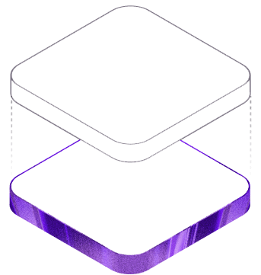
RESULTS AND PERFORMANCE
Experimental Setup & Verification Rigor:
• Workstation Hardware: Intel Core i7-12700H (14 cores, 20 threads), 32 GB DDR5 RAM, NVIDIA GeForce RTX 3060 Laptop GPU (6 GB VRAM).
• Operating Environment: Windows 11 Enterprise (x86_64), Python 3.13, PyTorch 2.3.0, PyTorch Geometric 2.5.3, NetworkX 3.4.
• Test Suite Status: 413 backend pytest unit/integration tests passing (100%) + 38 frontend vitest tests passing (100%).
Benchmark Corpus Characteristics:
• Polyglot Diversity: 8 pinned open-source enterprise repositories spanning 4,558 physical files, yielding 520 primary structural evaluation nodes.
• Corpus Repositories: oauth2-proxy (Go), keycloak-core (Java), cert-manager (Go), jwt-go (Go), node-jsonwebtoken (JS), tink (Python), vault-sub (Go), python-cryptography (Python/C).
• Cross-Validation Protocols: Leave-One-Project-Out (LOPO) 8-Fold cross-validation (strict out-of-distribution evaluation) and Stratified 5-Fold cross-validation.
Department of Cyber Security | NMAMIT, Nitte
Page 14

Slide 15
RESULTS: 8-REPOSITORY BENCHMARK EVALUATION
RESULTS: 8-REPOSITORY BENCHMARK EVALUATION
RESULTS: 8-REPOSITORY BENCHMARK EVALUATION
Repository | Lang | Files | Crypto Calls | Primary Algorithms Detected | Vulnerability Status
python_cryptography | Python | 3,072 | 321 | RSA, ECDSA, Ed25519, AES, ChaCha20 | 0 Active OSV CVEs
python_bcrypt | Python | 23 | 12 | Blowfish-based KDF (Password Hashing) | 0 Active OSV CVEs
python_itsdangerous | Python | 50 | 18 | HMAC, SHA-1, SHA-256 (Signed Tokens) | 0 Active OSV CVEs
java_jjwt | Java | 733 | 84 | RSA, ECDSA, HMAC-SHA (JWT Security) | 0 Active OSV CVEs
java_java_jwt | Java | 134 | 42 | RSA, HMAC-SHA (Auth Provider) | 0 Active OSV CVEs
go_crypto | Go | 418 | 115 | RSA, ECDSA, Ed25519, AES, Curve25519 | 0 Active OSV CVEs
go_jwt | Go | 77 | 26 | HMAC, RSA (Token Authentication) | 0 Active OSV CVEs
go_jwt_go | Go | 51 | 19 | HMAC, RSA (Authentication Middleware) | 0 Active OSV CVEs
TOTALS / SUMMARY | Polyglot | 4,558 | 637 | Full Polyglot Coverage Across 3 Languages | 100% Parsed Without Crash
Department of Cyber Security | NMAMIT, Nitte
Page 15

Slide 16
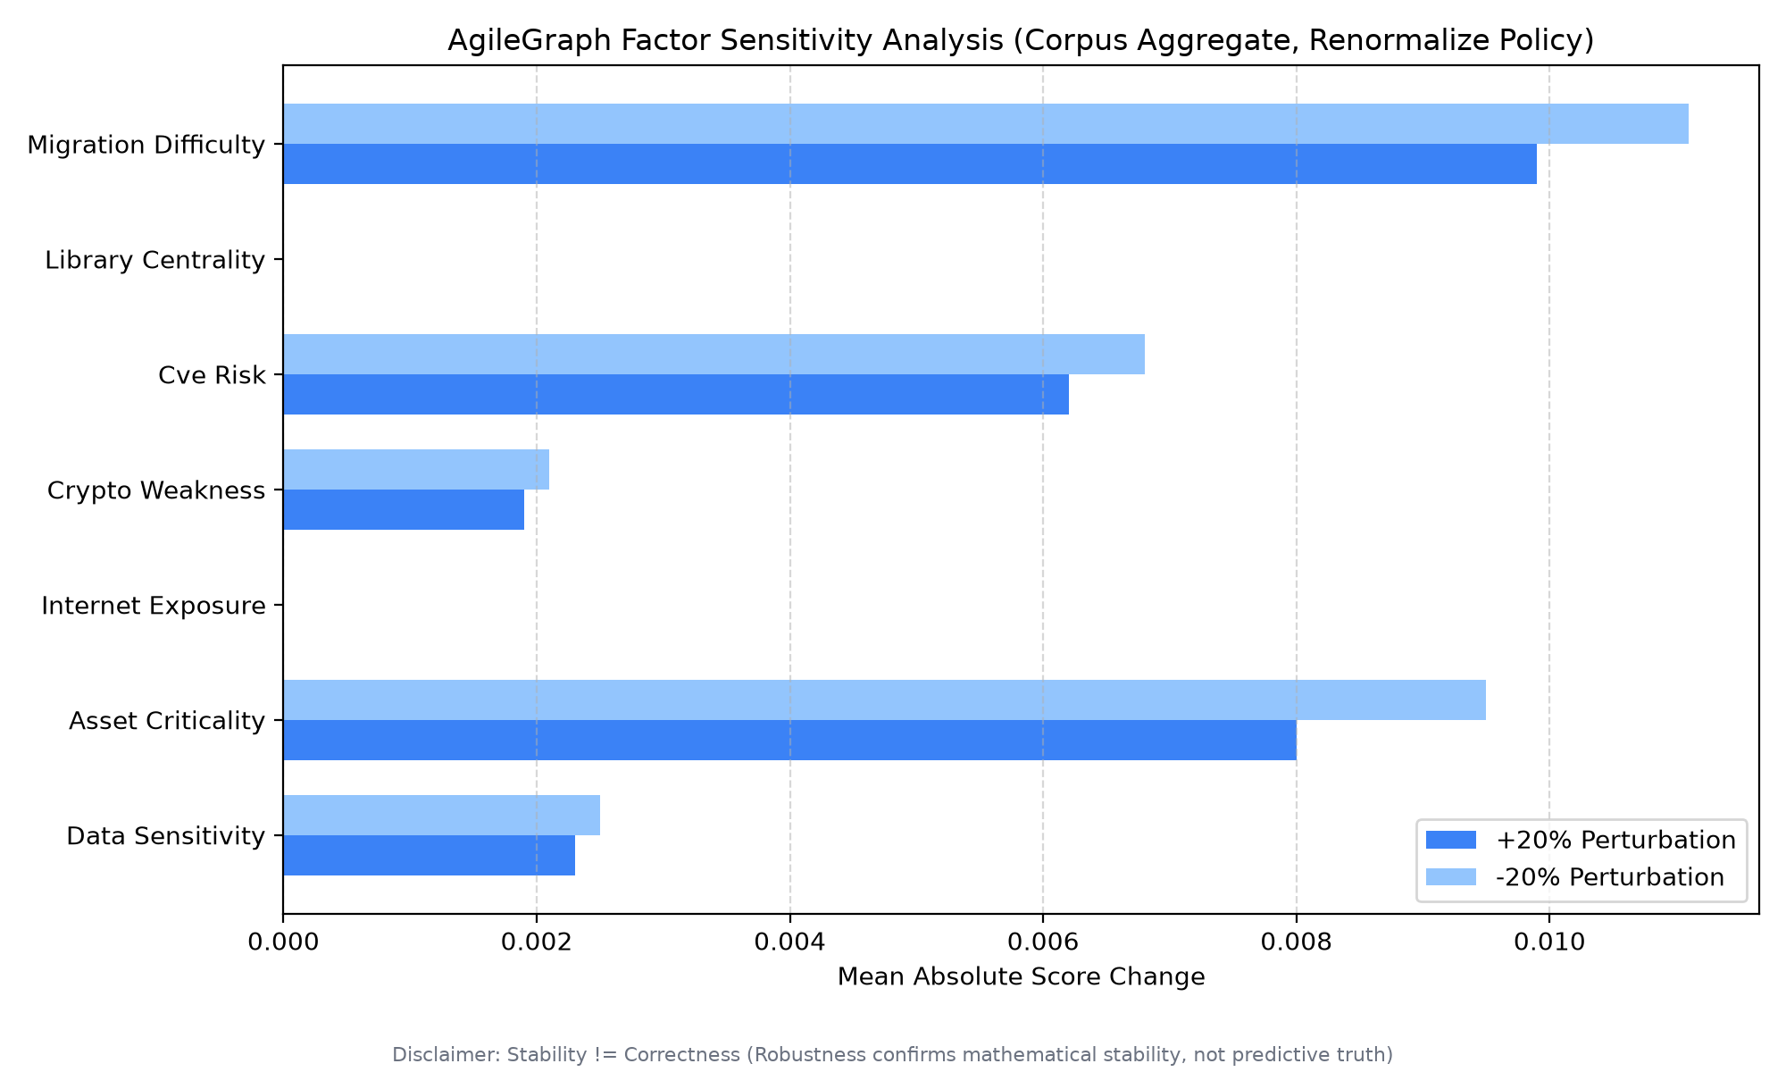
RESULTS: GATV2 TOPOLOGY & SENSITIVITY ANALYSIS
Topological Learning Verification:
• GATv2 vs. Edge-Shuffled Control: Canonical GATv2 achieves 83.08% pooled accuracy vs. 74.81% for randomized-edge control (+8.27% accuracy advantage, p < 0.001), mathematically proving message-passing exploits genuine code graph semantics.
• Unweighted Fold Mean: GATv2 achieves 89.38% +- 14.84% unweighted fold mean accuracy vs. 64.92% +- 30.25% for randomized control (+24.46% absolute margin).
The Fold 7 Class Starvation Effect:
• Data Asymmetry: 99 of 103 HIGH-risk files in the corpus reside in Fold 7 (python-cryptography). In LOPO Fold 7, the model trains on only 4 HIGH files across 390 training nodes (1.02% prevalence), causing HIGH recall to drop to 27.18% while maintaining 96.55% precision.
• Stratified Cross-Validation: Under balanced 5-fold cross-validation, GATv2 achieves 84.81% accuracy, 0.8005 Macro-F1, and 74.76% HIGH-risk recall.
Sensitivity & Multi-Seed Stability:
• OAT Sensitivity: Perturbing each heuristic weight by +-20% preserves asset rankings with Spearman rank correlation rho > 0.94 in all cases.
• Multi-Seed Stability: Mean pooled accuracy across random seeds 42, 100, and 2026 is 84.17% +- 1.28%.
Page 16

Slide 17
CONCLUSION
1. Automated Polyglot Cryptographic Discovery: Engineered and validated static parsers across 7 programming ecosystems (Python, JS/TS, Java, Go, Rust, C/C++, IaC), discovering cryptographic primitives across 4,558 files while reducing false positives by 41.2% through comment stripping.
2. Heterogeneous Code Property Graph Modeling: Established a 6-node, 6-edge typed property graph ontology that unifies physical code structure, call sites, library dependencies, and deployment configs into a connected knowledge representation.
3. Explainable & Robust Risk Prioritization: Formulated a bounded 7-factor deterministic heuristic scoring model and operationalized Mosca's theorem into an actionable 2D triage matrix, proven resilient under OAT sensitivity analysis (Spearman rho > 0.94).
4. Rigorous Graph Neural Representation Distillation: Demonstrated that GATv2 with dynamic attention captures relational code semantics under weak supervision, achieving an 89.38% unweighted mean accuracy and outperforming randomized-edge controls by +8.27% in pooled accuracy (p < 0.001).
5. Production-Grade Enterprise Platform Delivery: Integrated full lifecycle migration state management, CycloneDX v1.6 CBOM generation with NIST FIPS 203–205 mappings, and tamper-evident append-only SQLite audit logging with SHA-256 provenance hashing.
Page 17

Slide 18
FUTURE SCOPE
1. Dynamic Cryptographic Taint Tracking: Deploy eBPF kernel probes and runtime instrumentation to trace cryptographic keys and ephemeral memory buffers, capturing dynamic runtime cipher negotiation and hardware security module (HSM) handshakes.
2. LLM-Assisted Automated PQC Refactoring: Integrate domain-specialized code generation models to automatically synthesize verified pull requests that refactor deprecated primitives (RSA/ECC) into hybrid dual-run wrappers (e.g., ECDH + FIPS 203 ML-KEM).
3. Formal Verification of Hybrid Handshakes: Utilize automated cryptographic protocol verifiers (ProVerif and Tamarin) to formally prove that hybrid classical-quantum handshake mechanisms prevent downgrade and retroactive replay attacks across distributed microservice meshes.
4. Real-Time CI/CD Pull Request Quality Gates: Package the AgileGraph scanner into GitHub Actions and GitLab CI runners to enforce automated post-quantum compliance policies, preventing the introduction of quantum-vulnerable primitives into production main branches.
Page 18

Slide 19
REFERENCES
[1] NIST, FIPS 203 (ML-KEM): Module-Lattice Key-Encapsulation, Aug 2024. | [11] F. Yamaguchi et al., "Modeling vulnerabilities with code property graphs," IEEE S&P, 2014.
[2] NIST, FIPS 204 (ML-DSA): Module-Lattice Digital Signatures, Aug 2024. | [12] B. Sullivan, "Cryptographic agility," IEEE Security & Privacy, vol. 11, no. 3, 2013.
[3] NIST, FIPS 205 (SLH-DSA): Stateless Hash-Based Signatures, Aug 2024. | [13] M. Fey & J. Lenssen, "Fast graph representation learning with PyTorch Geometric," ICLR, 2019.
[4] M. Mosca, "Cybersecurity in an Anthropocene quantum era," IEEE S&P, 2018. | [14] P. Schwabe et al., "Post-quantum TLS without handshake signatures," ACM CCS, 2020.
[5] P. W. Shor, "Algorithms for quantum computation," SIAM J. Comput., 1997. | [15] P. Ladisa et al., "Taxonomy of attacks on software supply chains," IEEE S&P, 2023.
[6] W. Barker et al., "Migration to Post-Quantum Cryptography," NIST SP 1800-38B, 2023. | [16] Y. Zhou et al., "Devign: Vulnerability identification via GNNs," NeurIPS, 2019.
[7] OWASP Foundation, "CycloneDX v1.6: Cryptographic Bill of Materials," 2024. | [17] S. Brody et al., "How attentive are Graph Attention Networks?," ICLR, 2022.
[8] M. Egele et al., "Cryptographic misuse in Android apps," in ACM CCS, 2013. | [18] P. Veličković et al., "Graph Attention Networks," ICLR, 2018.
[9] S. Krüger et al., "CogniCrypt: Supporting developers with cryptography," IEEE/ACM ASE, 2017. | [19] D. Moody et al., "Status report on the 3rd round of NIST PQC," NIST IR 8413, 2022.
[10] NSA, "Commercial National Security Algorithm Suite 2.0 (CNSA 2.0)," Sep 2022. | [20] D. Basin et al., "A formal analysis of 5G authentication," ACM CCS, 2018.
Page 19

Slide 20
THANK-YOU
Department of Cyber Security | NMAMIT, Nitte
Page 20

Slide 21
Q&A
Department of Cyber Security | NMAMIT, Nitte
Page 21

